Slide 1
Course Agenda
Introduction to Microsoft Power BI
Architecture
Understanding features of Power BI
Introduction to Data Base concepts
Practicing Data Modelling in Power BI
Writing queries in Power BI.
Creating visualizations in Power BI
Building and publishing of reports
Discussion & Wrap-up
Notes:
Key Message(s):
Review the course agenda.
Note: After reviewing the agenda, move ahead to the next slide and introduce the topics that are discussed in the course.

Slide 2
Course content
Introduction to Microsoft Power BI
Architecture
Downloading power BI desktop
Understanding features of the Power BI Desktop Application
Importing data set into Power BI

Slide 3
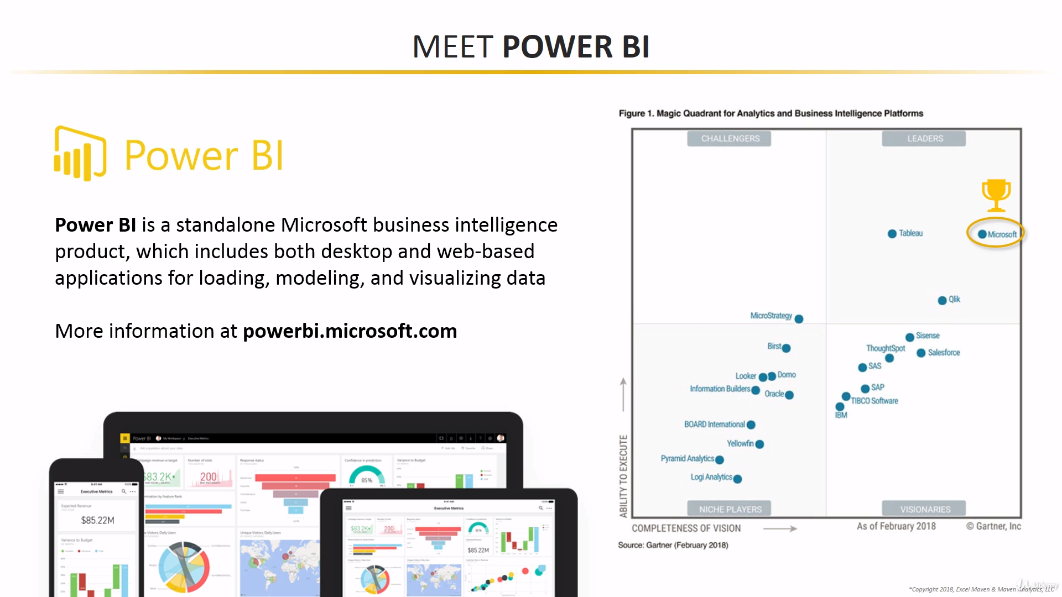

Slide 4
Power BI
Power BI is a Data Visualization and Business Intelligence tool that converts data from different data sources to interactive dashboards and BI reports.
Business Intelligence
Business intelligence (BI) combines business analytics, data mining, data visualization data tools and infrastructure, and best practices to help organizations to make more data-driven decisions.

Slide 5
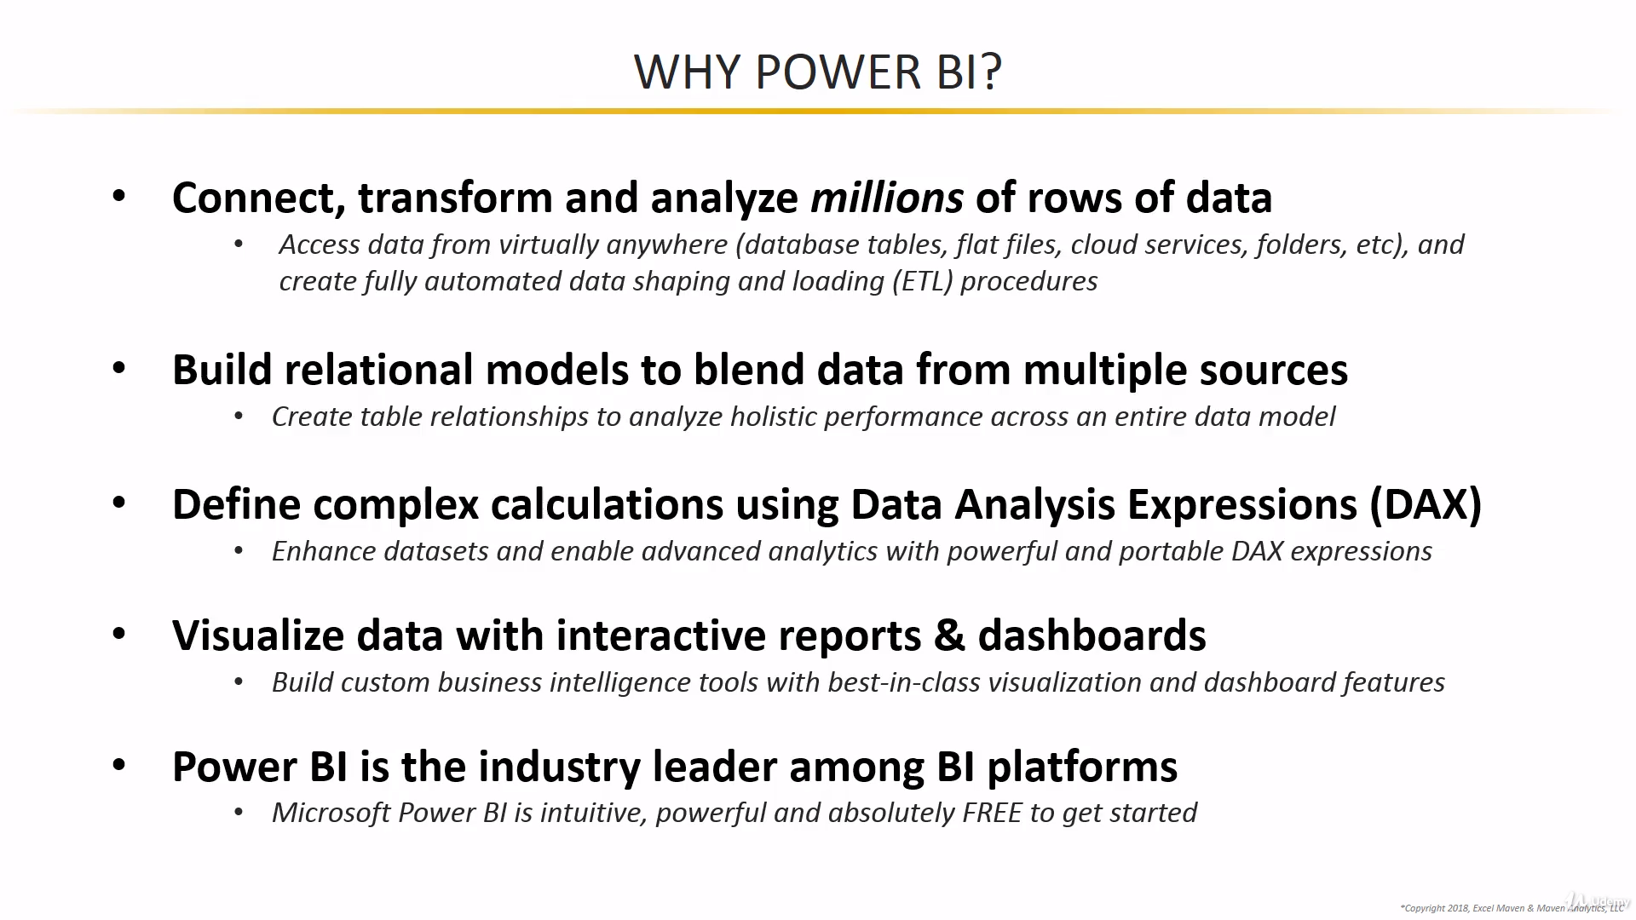

Slide 6
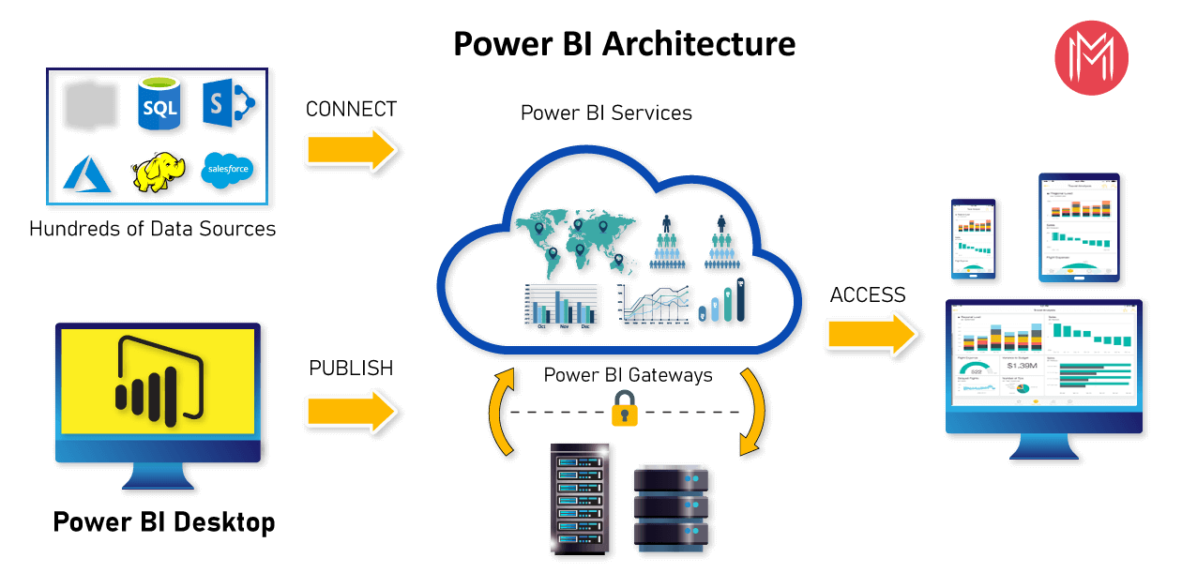
Architecture

Slide 7
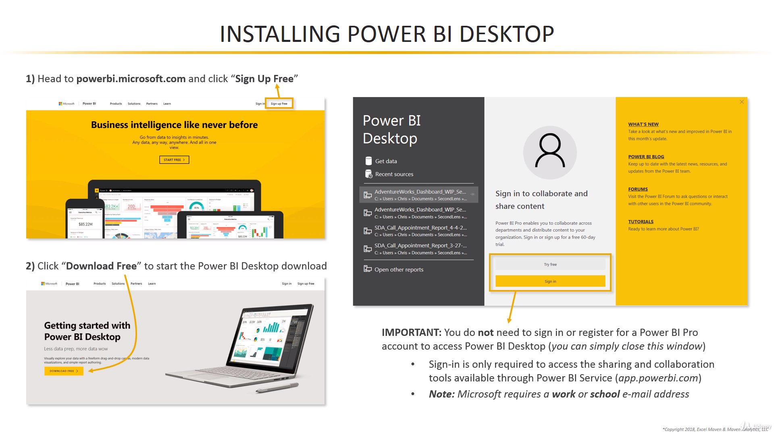

Slide 8
Installing Power BI
Power BI desktop app is used to create reports, while Power BI Services (Software as a Service - SaaS) is used to publish the reports.
https://powerbi.microsoft.com/en-us/downloads/

Slide 9
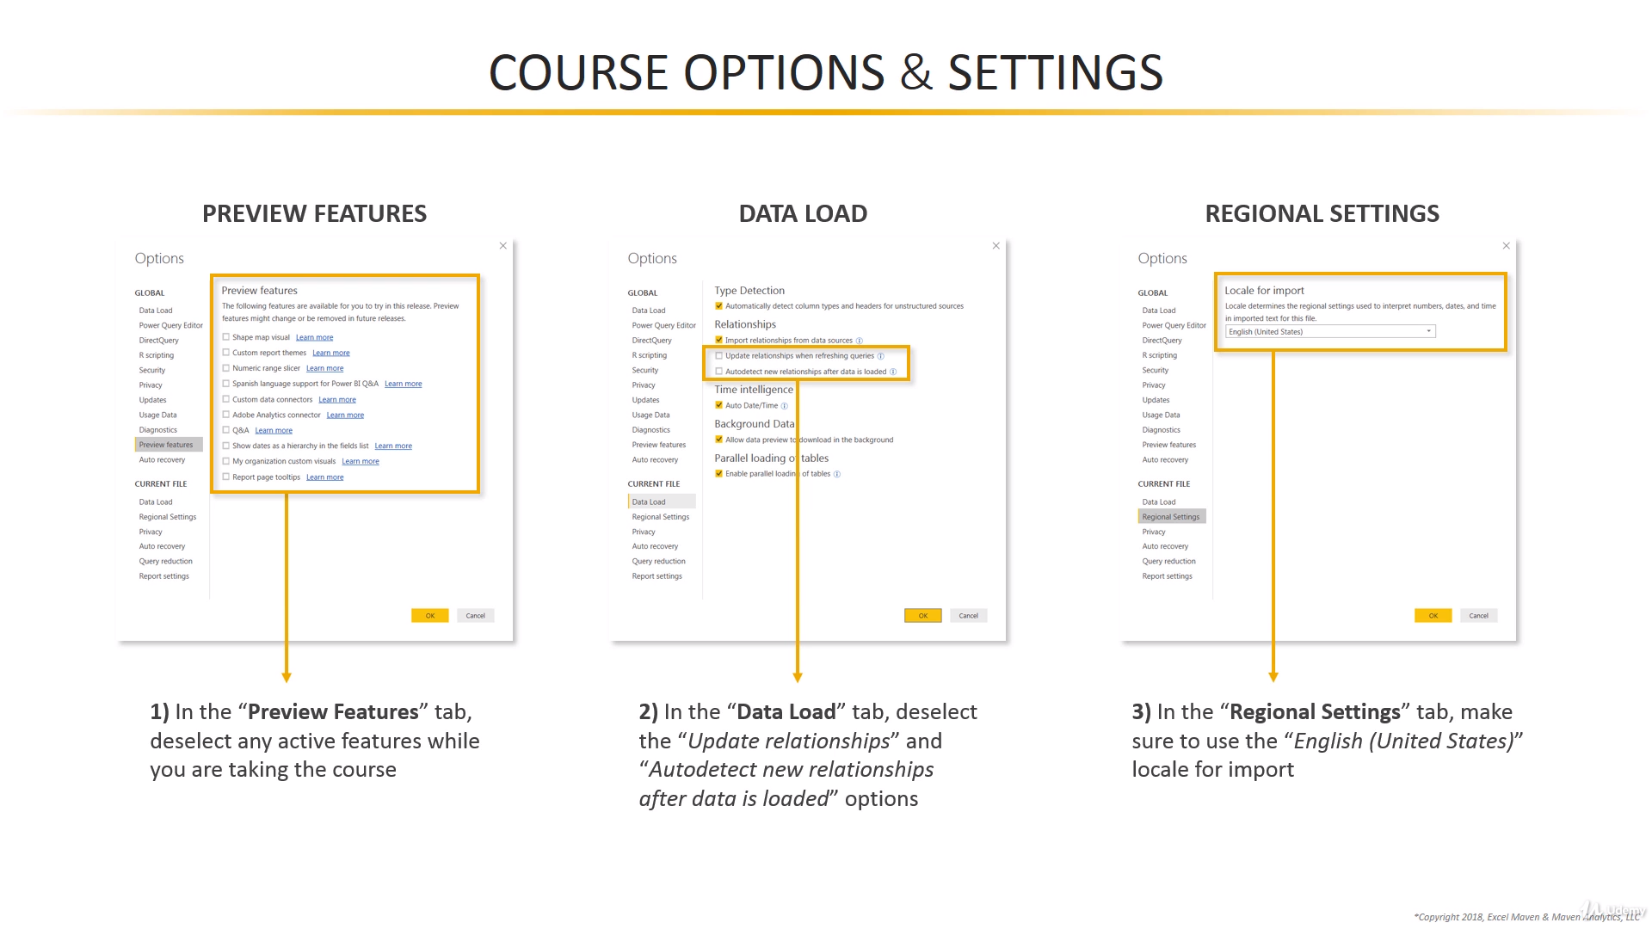

Slide 10
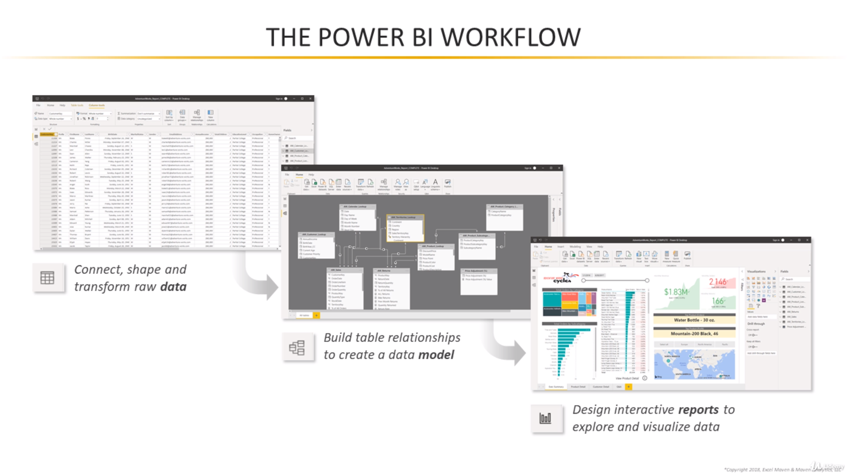

Slide 11
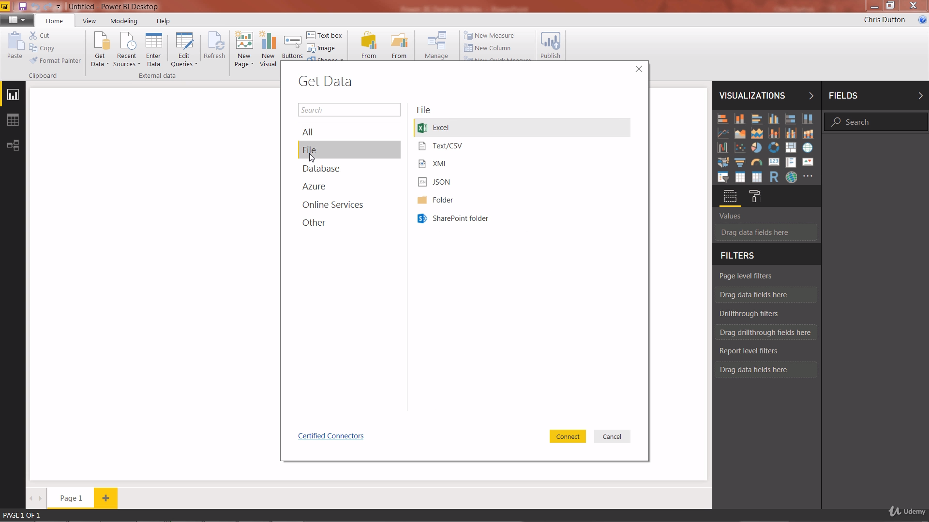
Data connectors

Slide 12
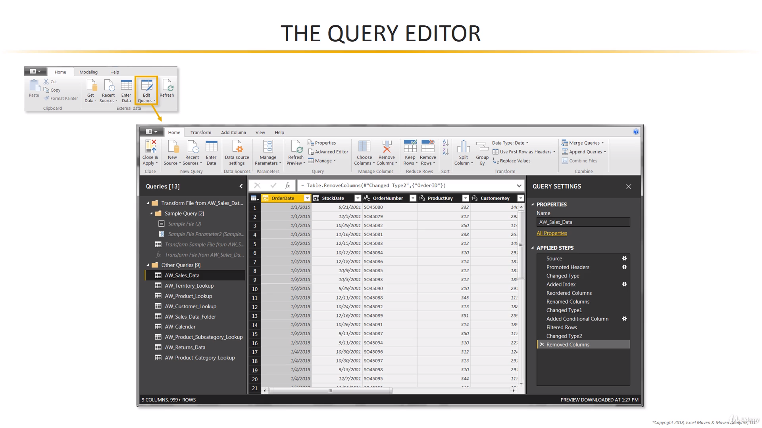

Slide 13
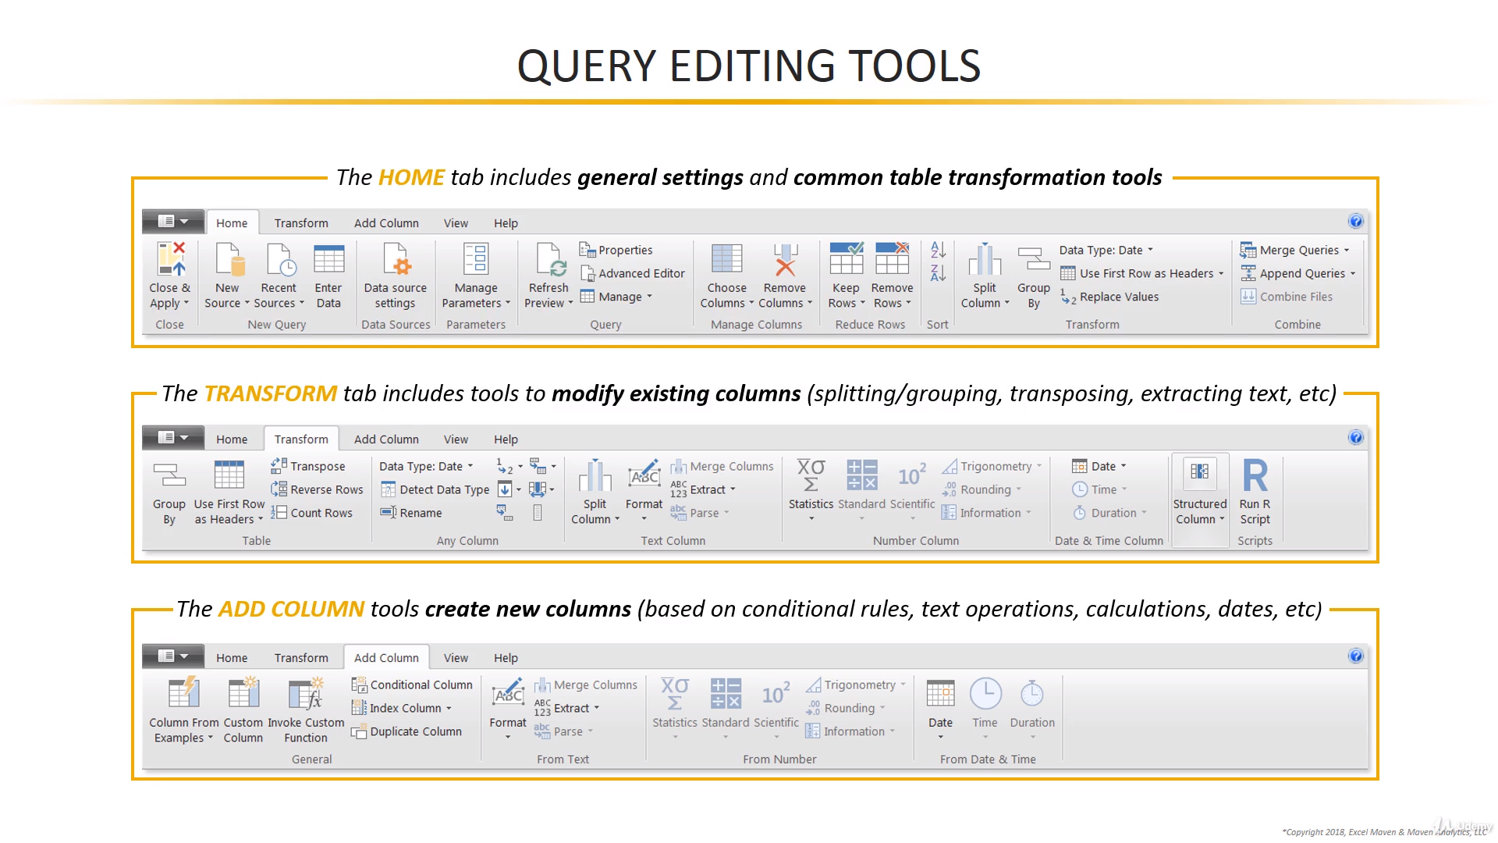

Slide 14
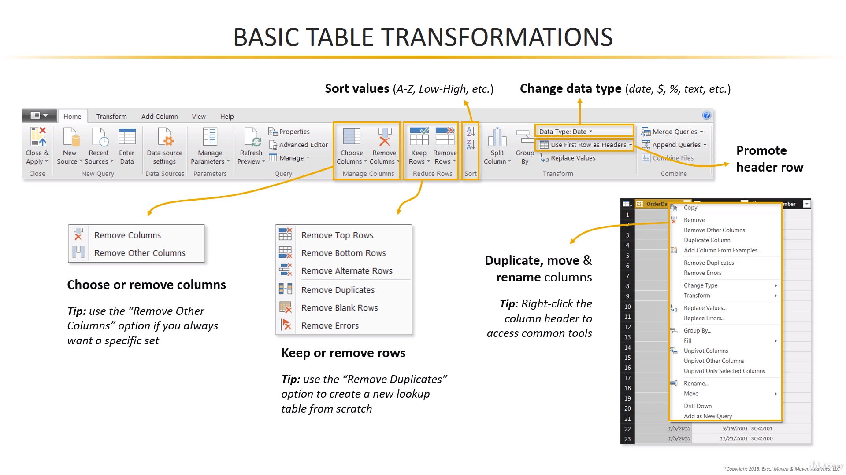

Slide 15
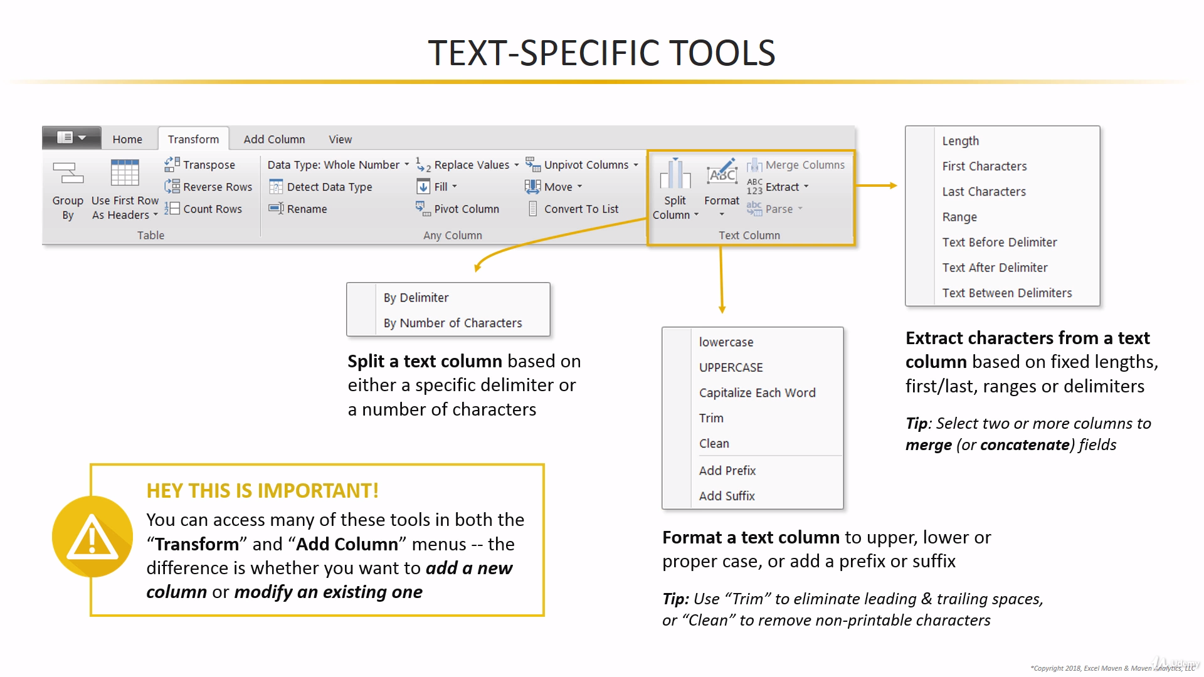

Slide 16
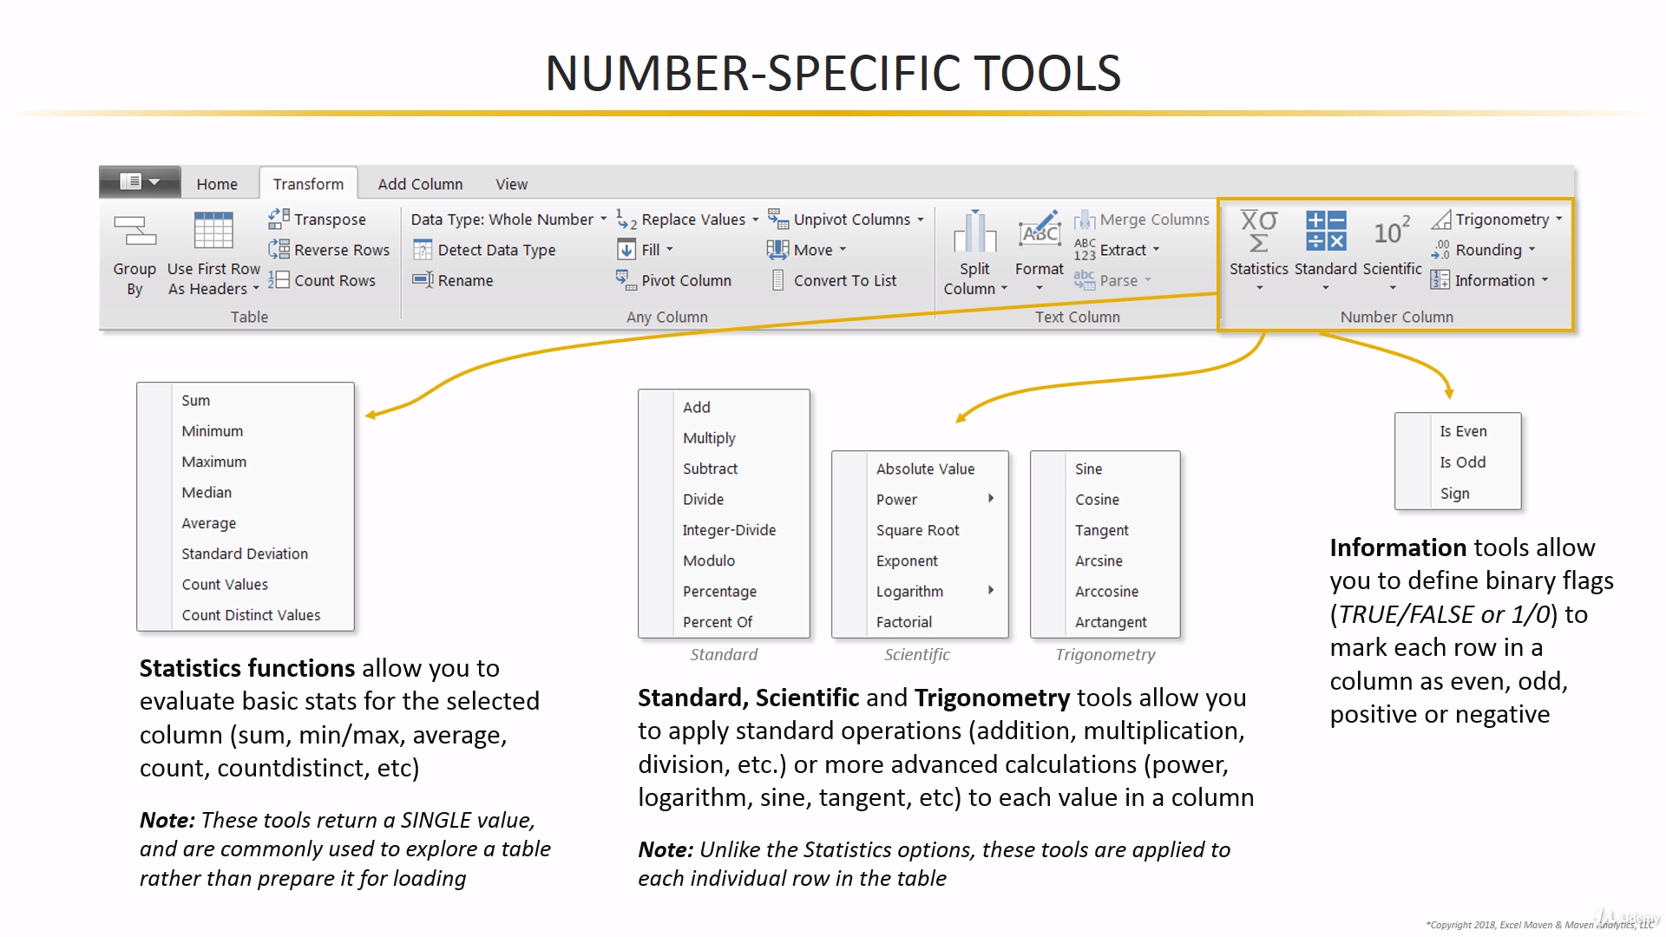

Slide 17
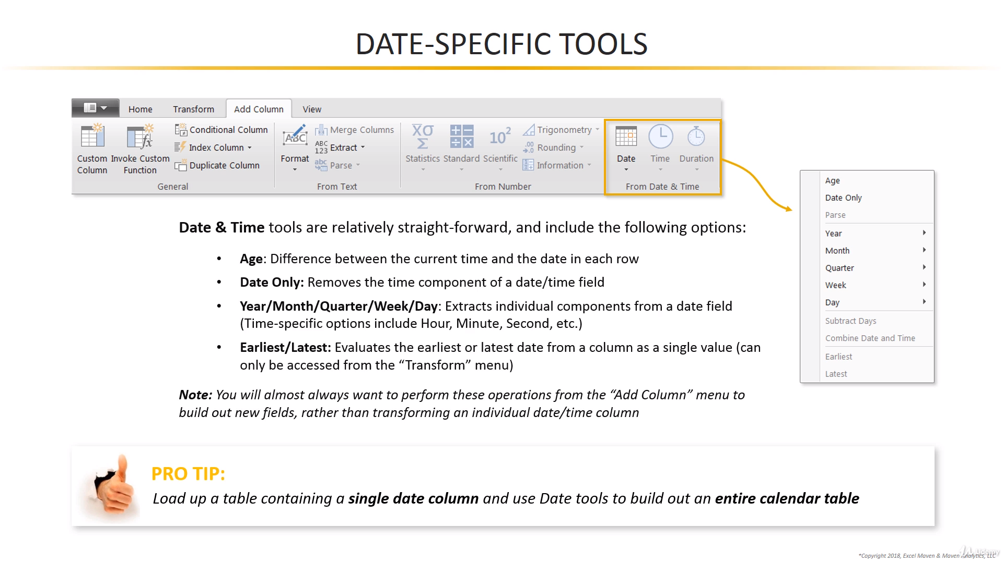

Slide 18
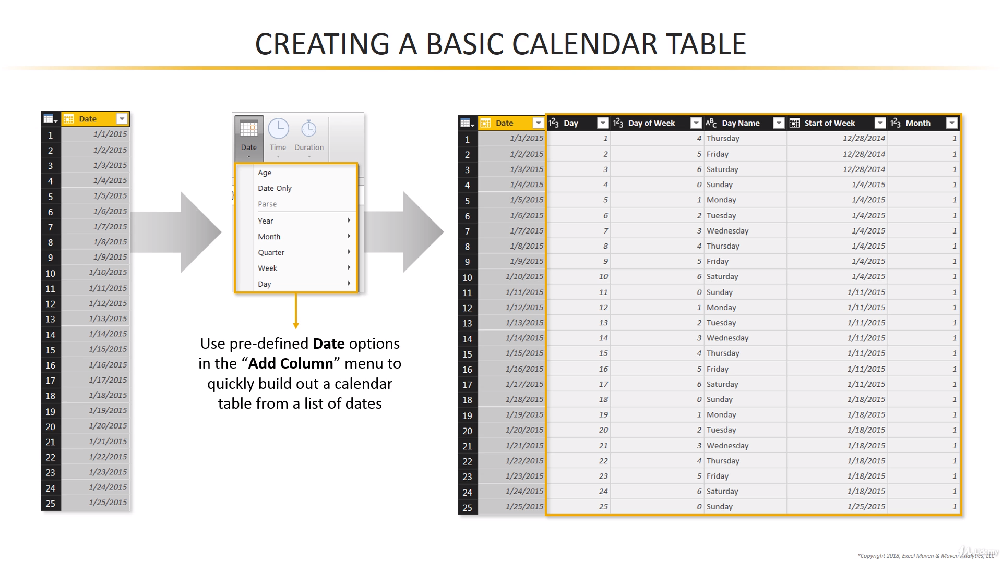

Slide 19
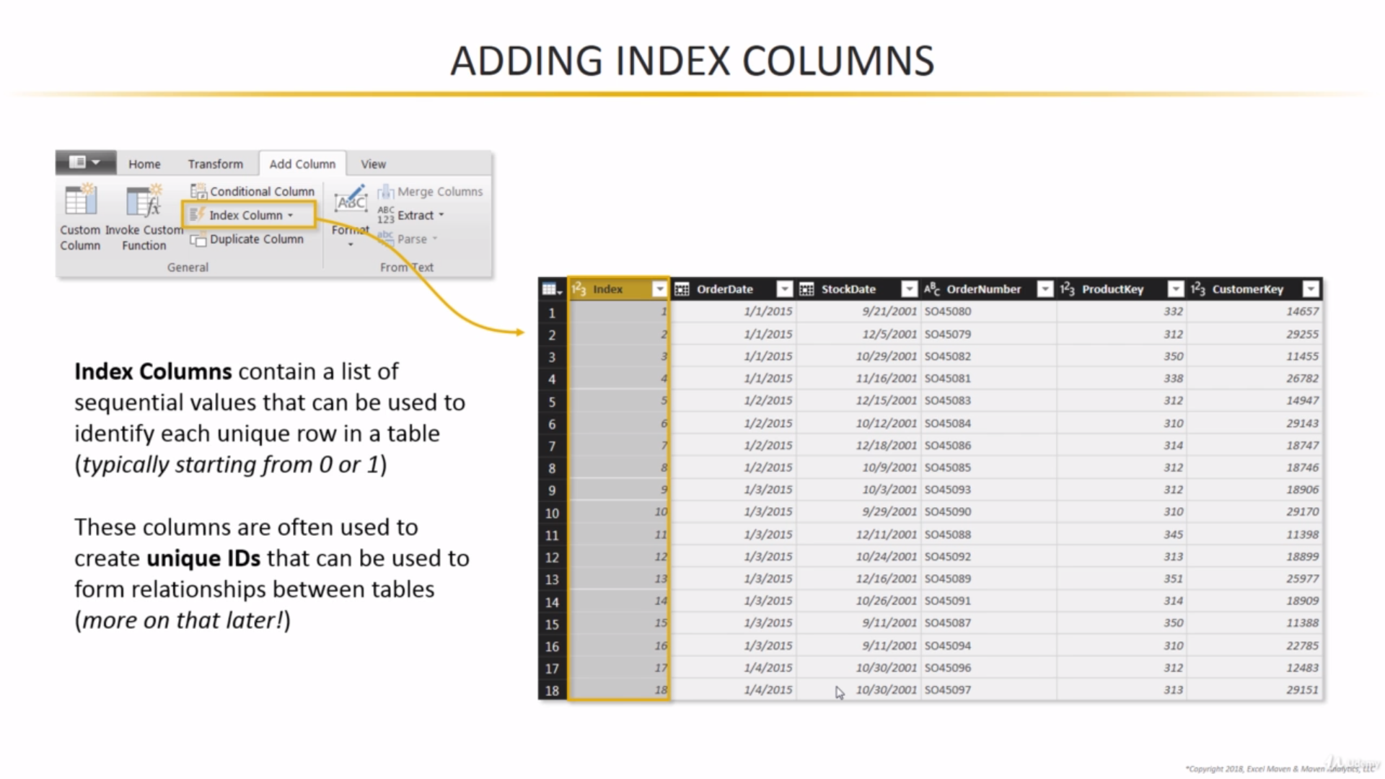

Slide 20
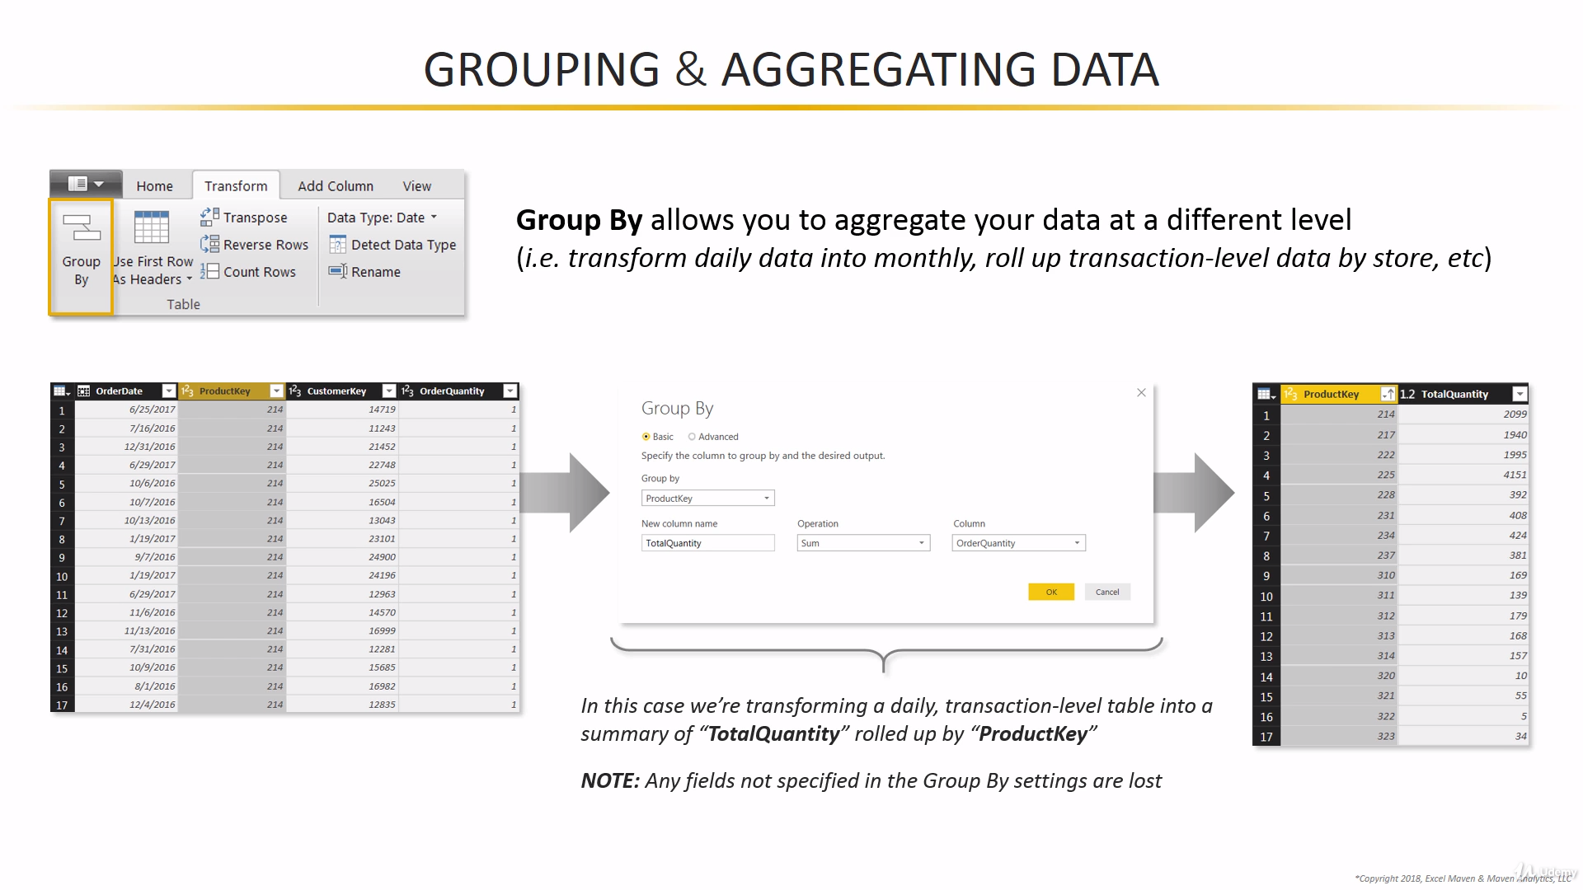

Slide 21
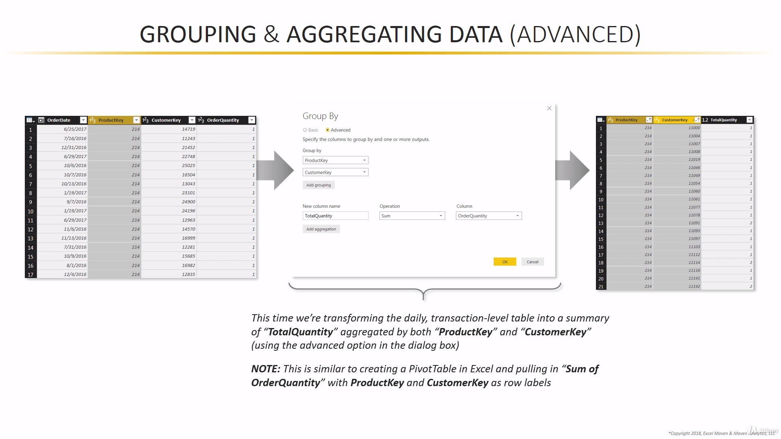

Slide 22
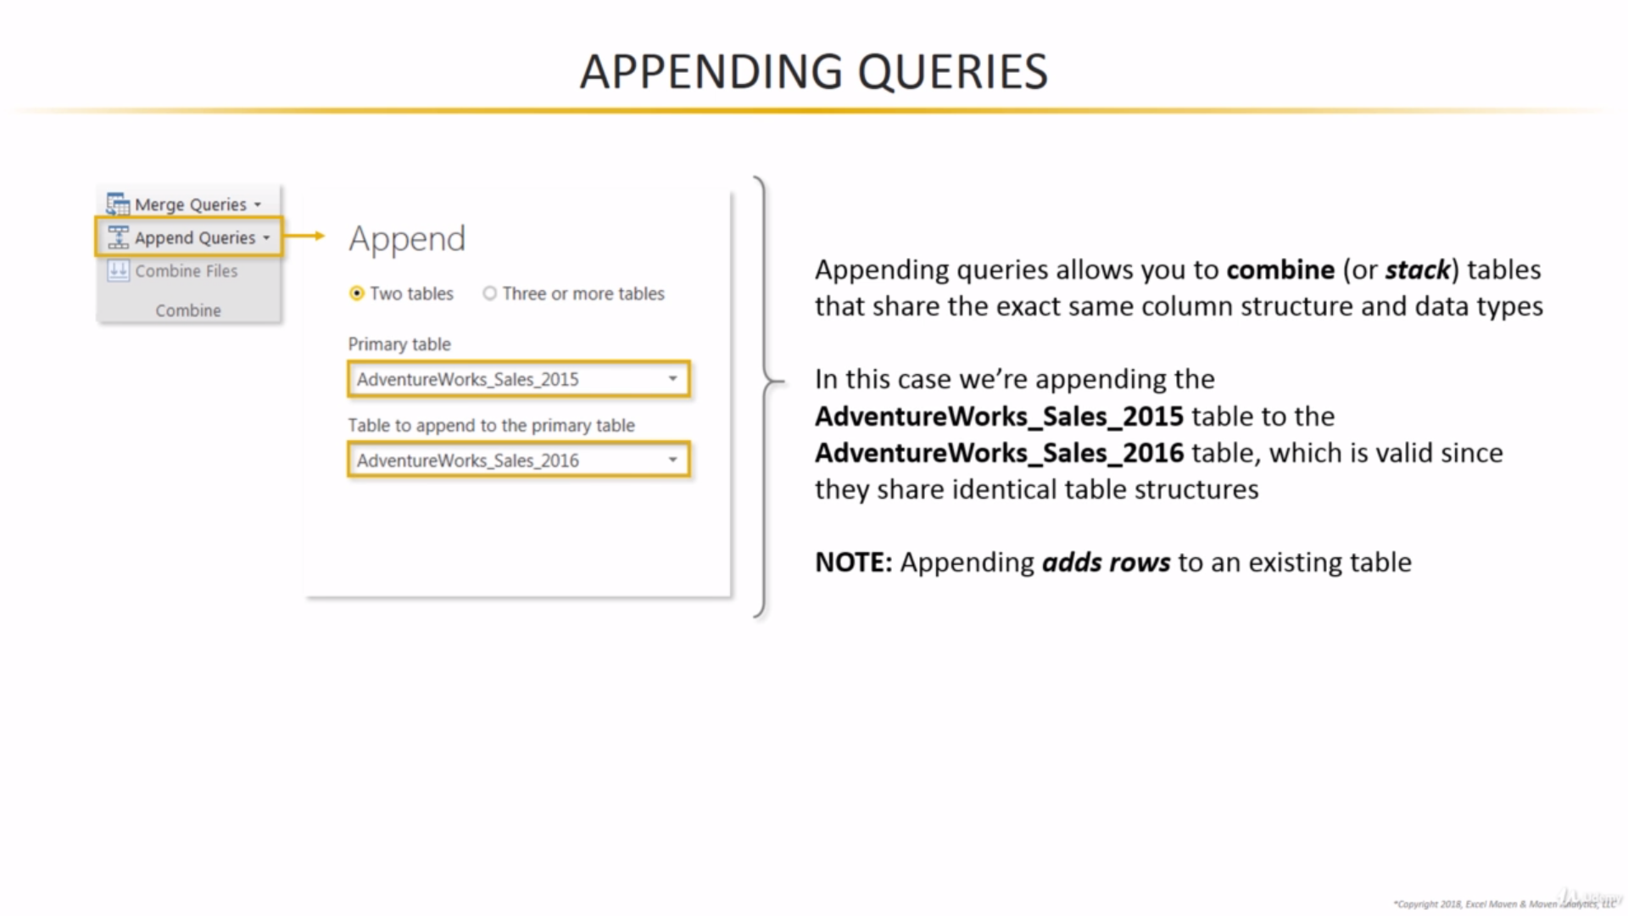

Slide 23
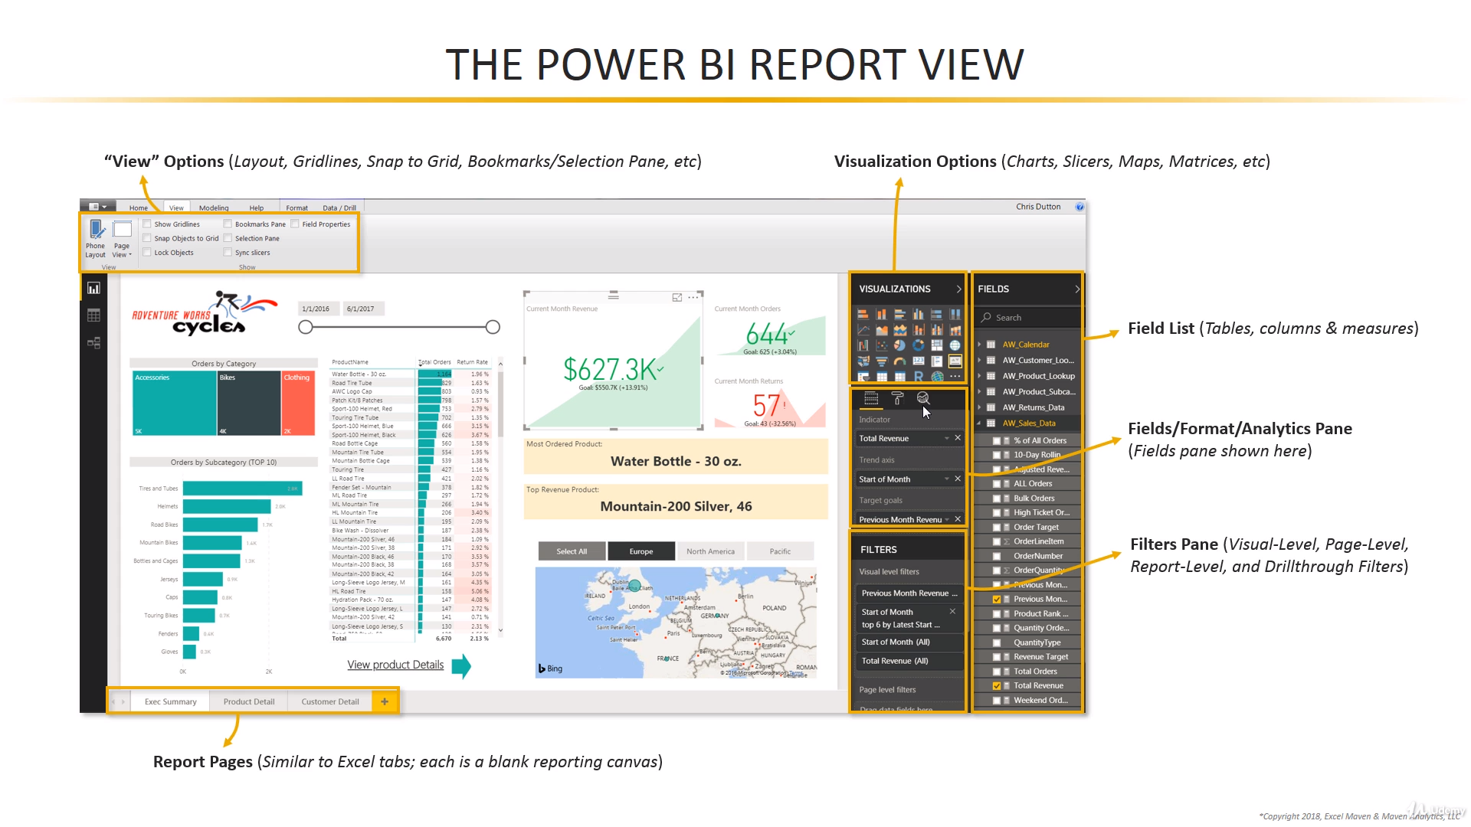

Slide 24
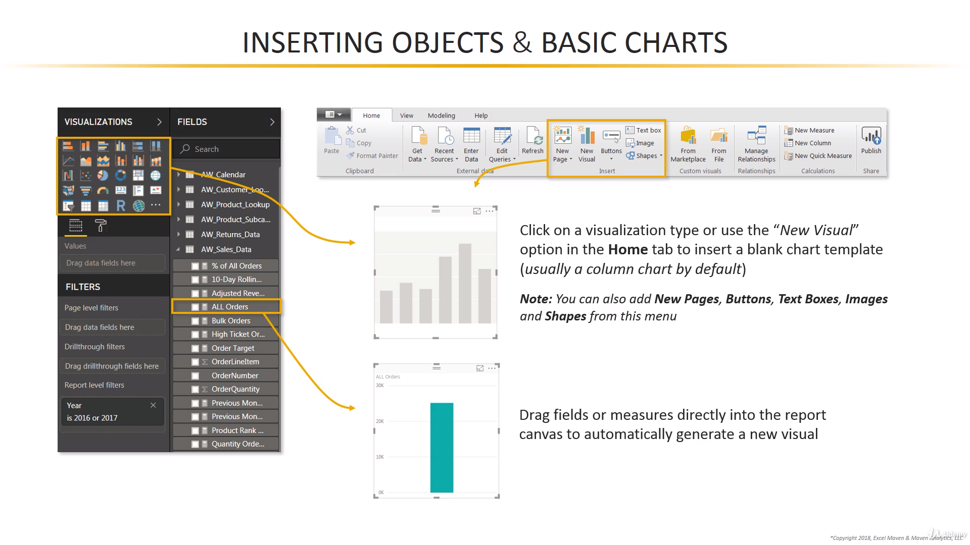

Slide 25
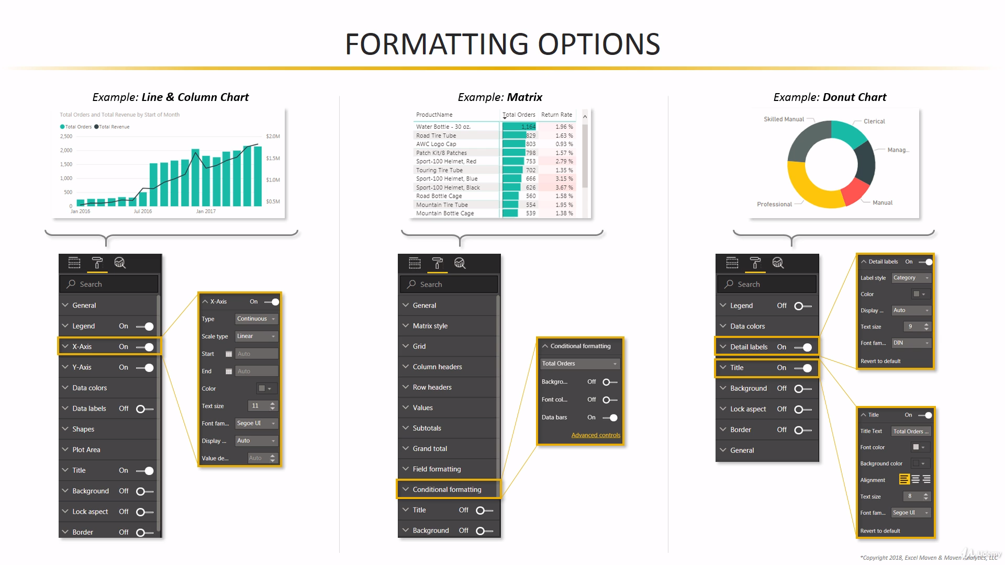

Slide 26
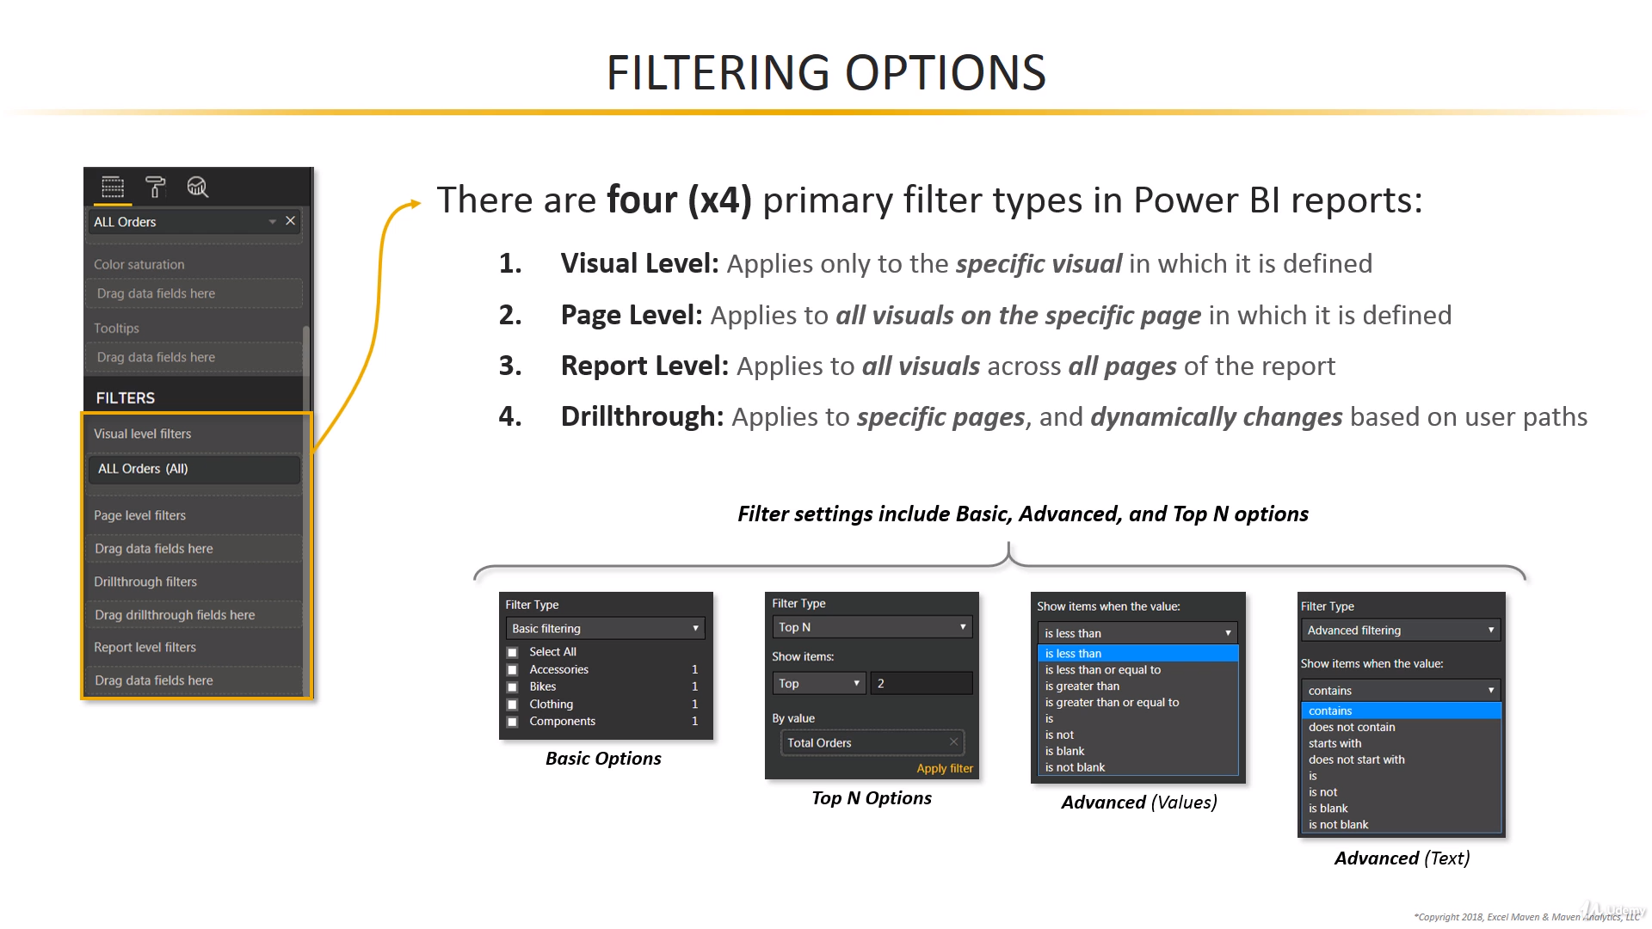

Slide 27
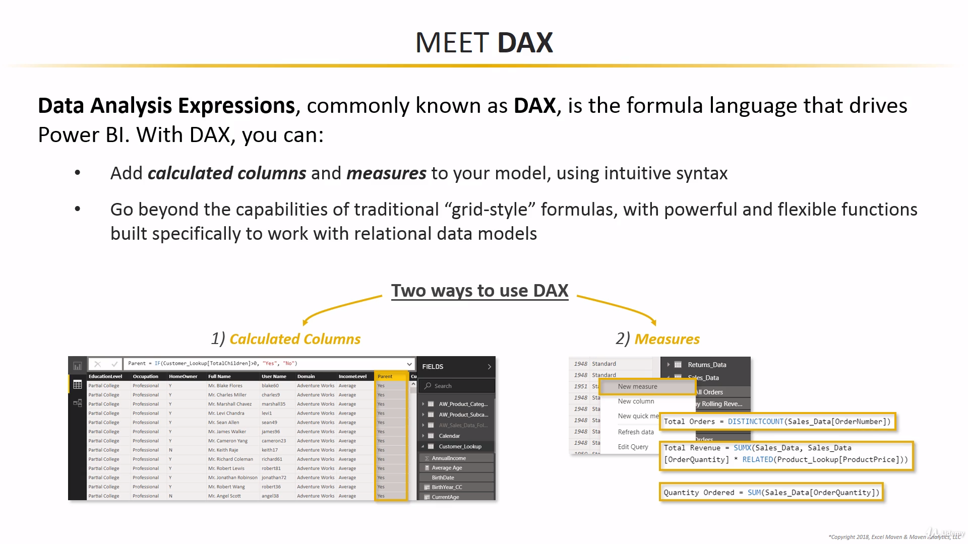

Slide 28
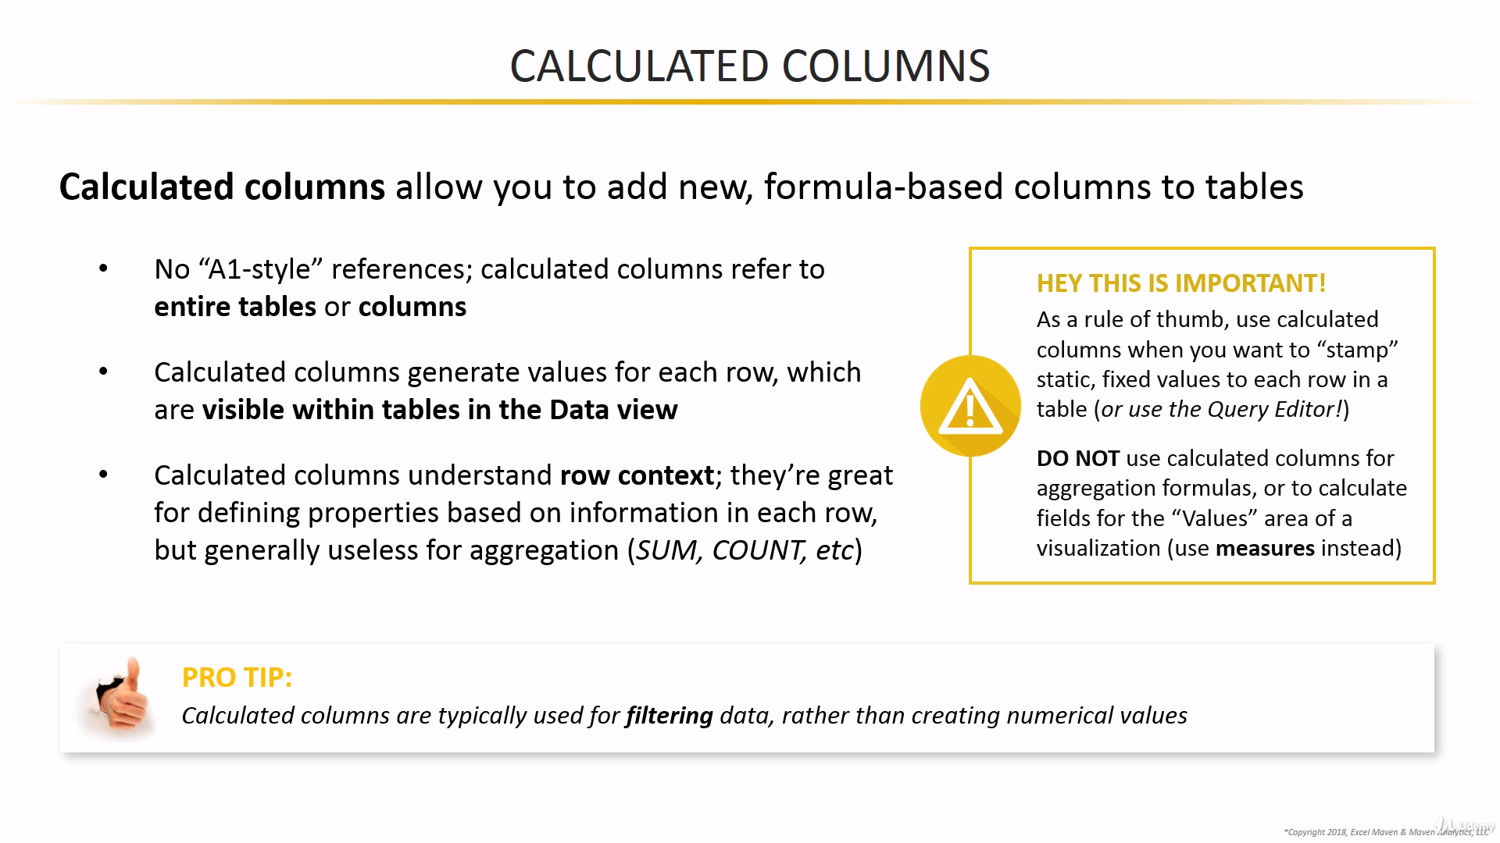

Slide 29
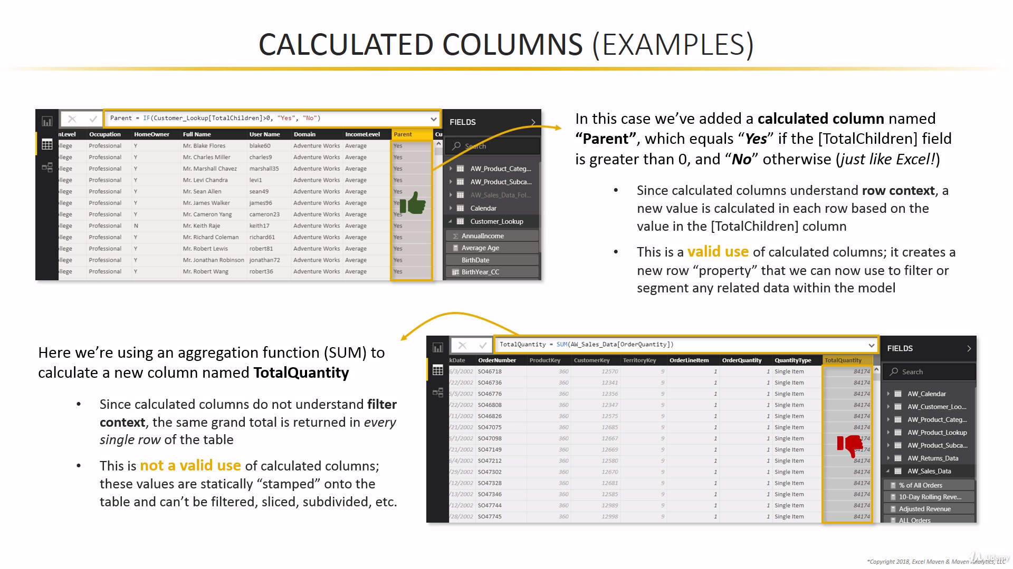

Slide 30
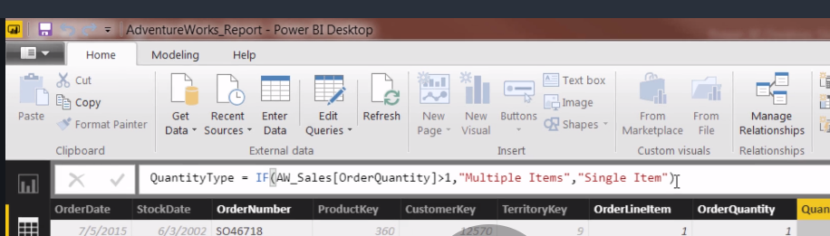
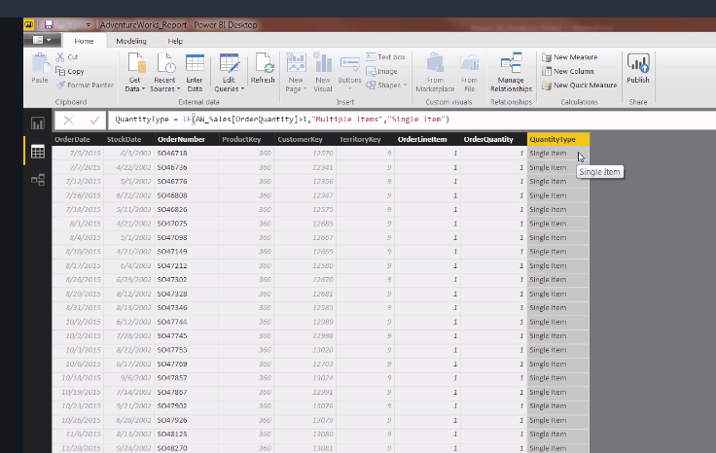

Slide 31
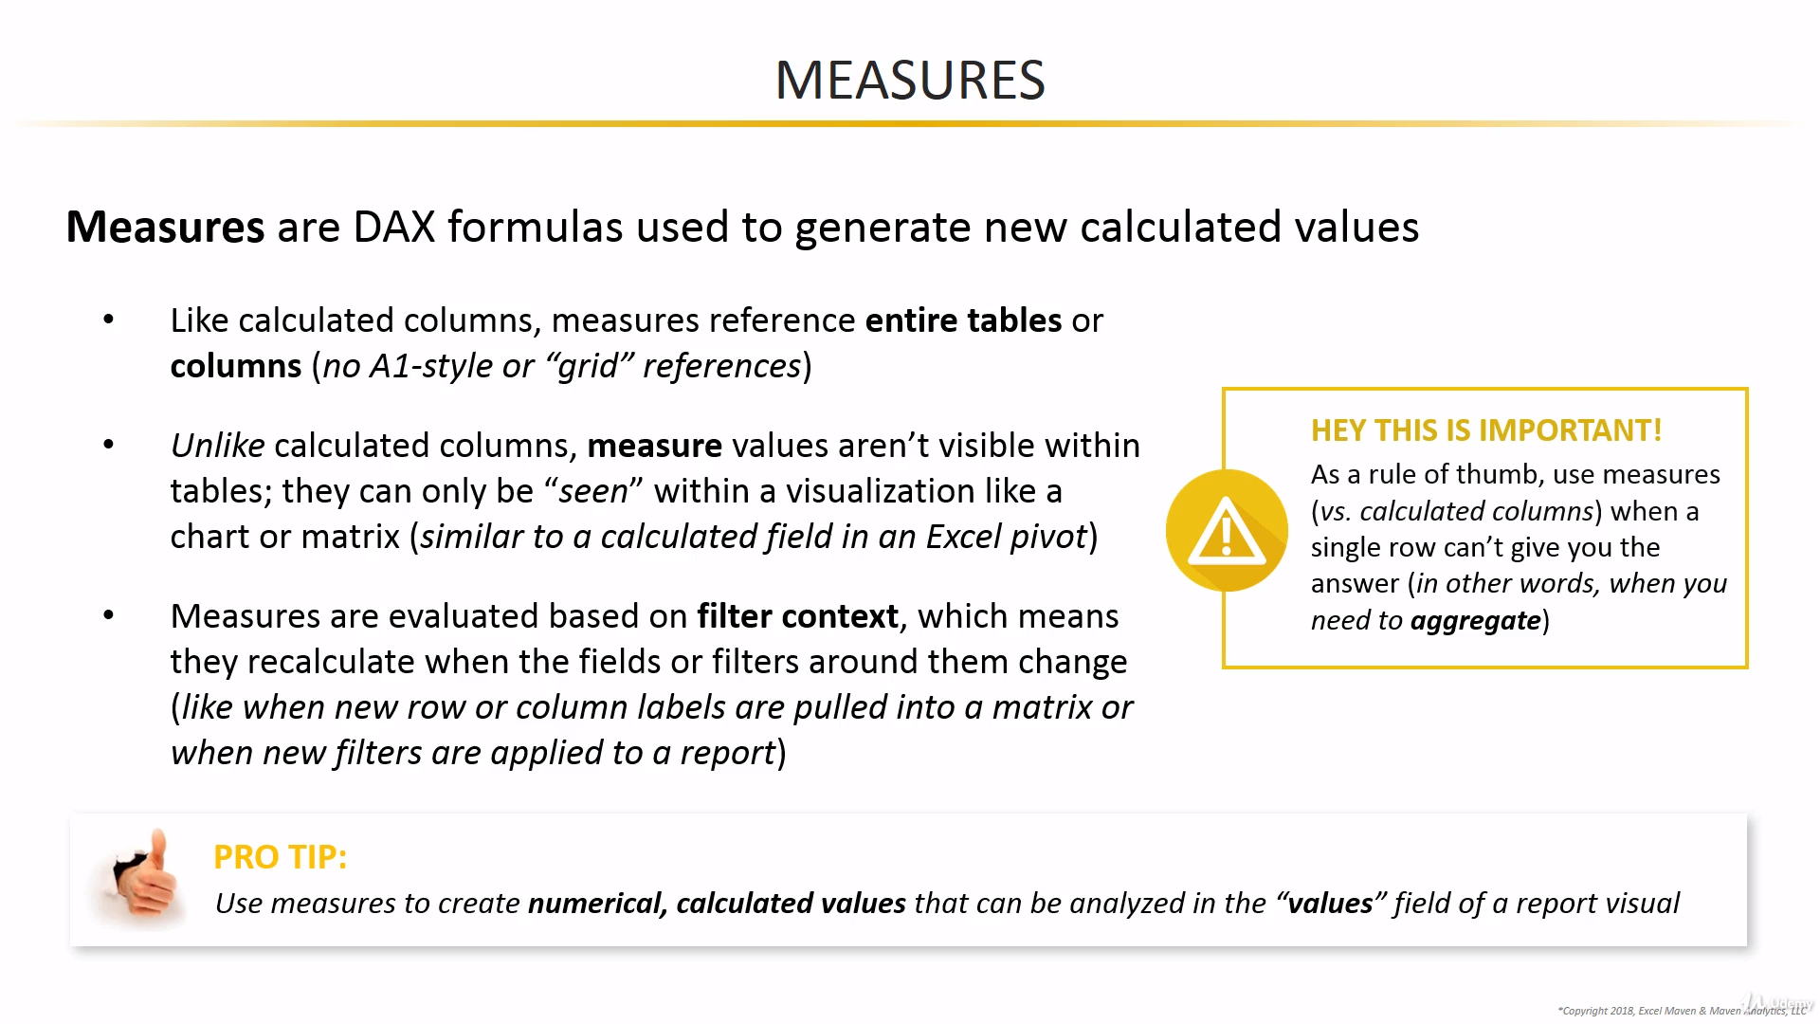

Slide 32
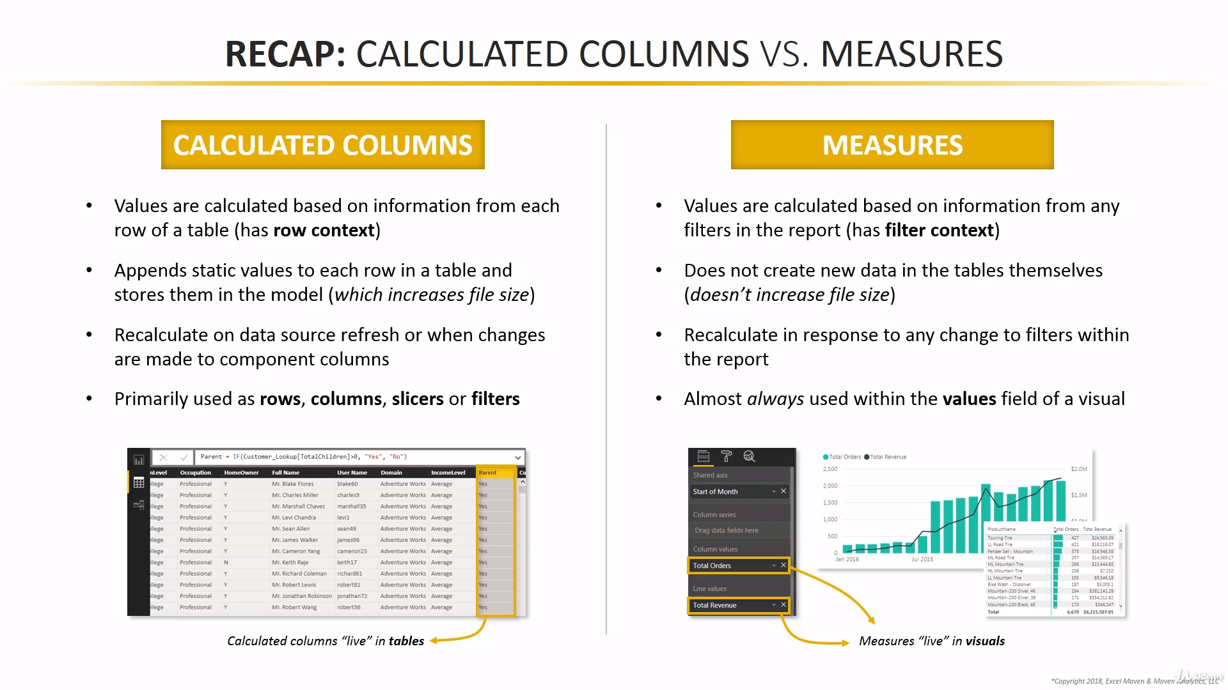

Slide 33
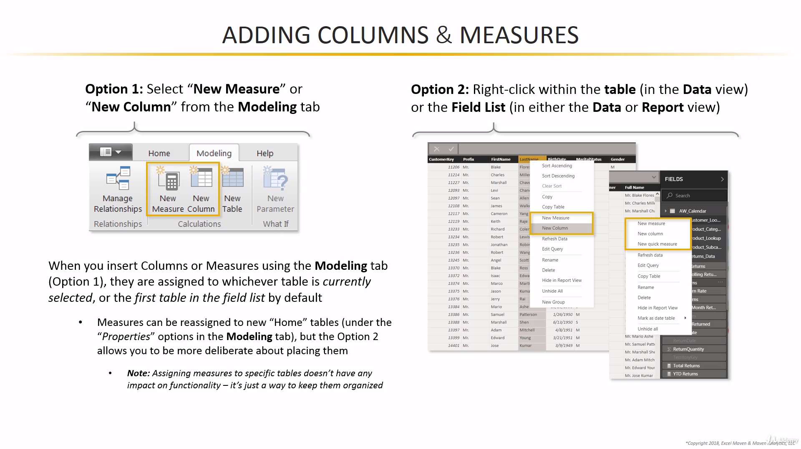

Slide 34
